Slide 1
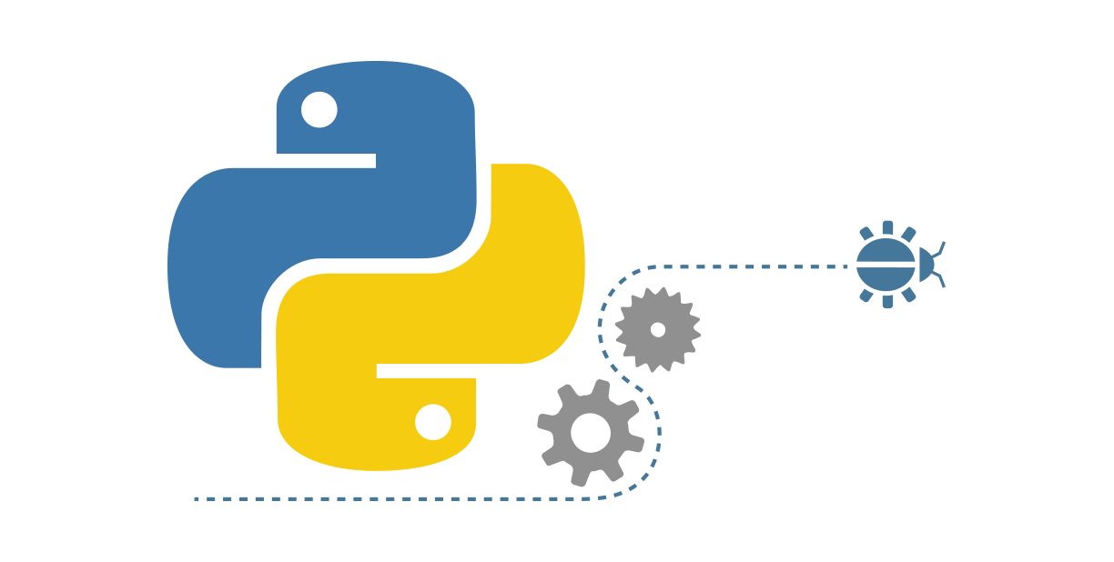

Python, your new favorite language.

Slide 2
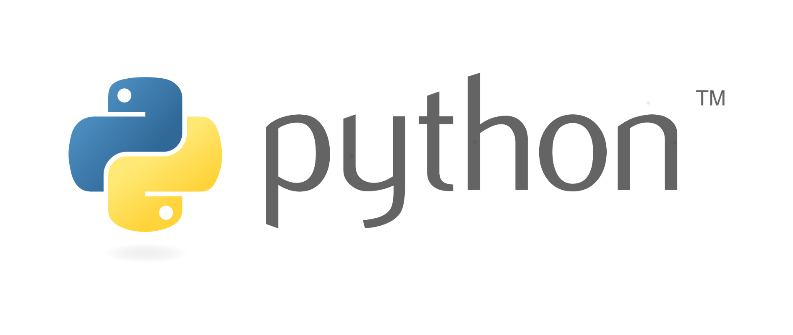
Agenda:
What is Python?
Why
Who uses it and how?
Comparison with other languages
Syntax
Python libraries
Pip
Building a library
Code example and explanation

Slide 3
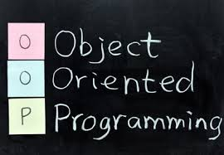
What is Python?
It’s an interpreted language which philosophy is to focus in a syntax that favors a readable code.
-Object Oriented -Imperative programming -Dynamic programming -Multiplatform

Slide 4
What is Python?
It is very attractive for Rapid Application Development.
Python’s simple, easy to learn syntax emphasizes readability and therefore reduces the cost of program maintenance.
Open source and managed by the Python software foundation.
Conceived in late 80’s by Guido Van Rossum in the Netherlands.

Slide 5
Why Python?
-The most popular introductory language in U.S. universities
- The fourth most popular language according to an IEEE survey behind old classics Java, C and C++.
-Increased Productivity
-No compilation step
-Edit-test-debug cycle is fast

Slide 6
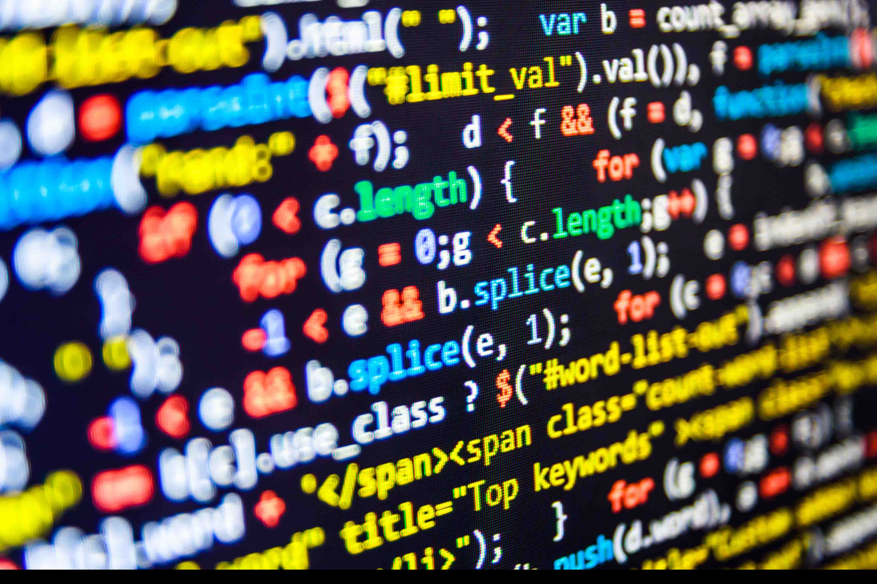
Who uses it and how?
Don’t think that because Python is easy to use it’s a weak language. Python is incredibly powerful - there’s a reason companies like Google, Dropbox, Spotify and Netflix use it.

Slide 7
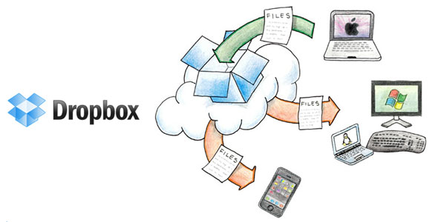
Who uses it and how?
Dropbox desktop client is written entirely in Python, the server-side code is in Python as well making it the majority language used at the company.

Slide 8

Who uses it and how?
Google uses a mix of languages, with Java, C++ and Python. Early on at Google, there was an engineering decision to use “Python where we can, C++ where we must.” It was used for parts that required rapid delivery and maintenance.

Slide 9
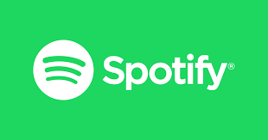
Who uses it and how?
Spotify uses Java heavily, but uses Python for things like the Web API and their Interactive API console, which lets developers explore endpoints with an easy-to-use interface. Also uses it for data analytics and other non-customer facing processes.

Slide 10
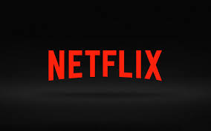
Who uses it and how?
Netflix uses a mix of Java, Scala, and Python, and gives developers autonomy when choosing which language fits the problem best. They heavily use Python in their real-time analytics group.

Slide 11
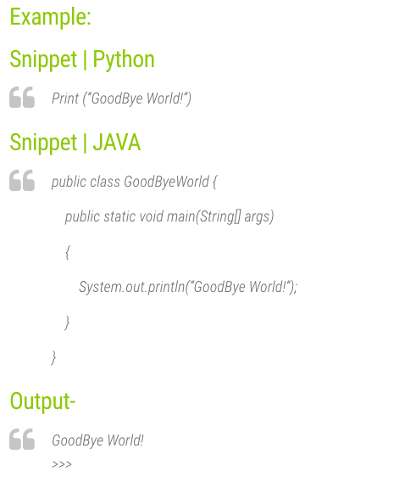
Comparison with other languages
Python vs Java -Python snippet takes very less memory in comparison to Java. -Python snippet for a particular functionality requires less number of lines.

Slide 12
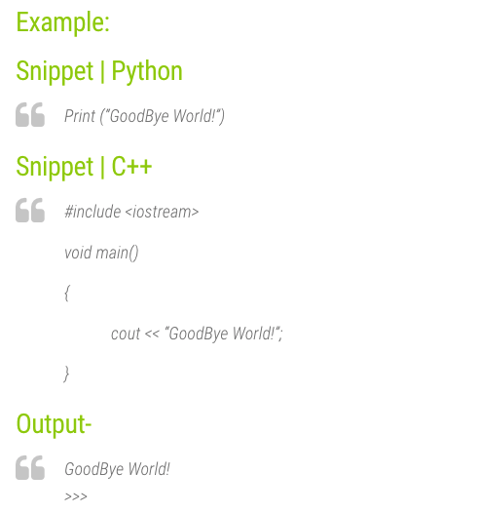
Comparison with other languages
Python vs C++ -Python provides much flexibility in calling functions and returning values than C++ -Python uses Garbage Collector whereas C++ doesn’t

Slide 13
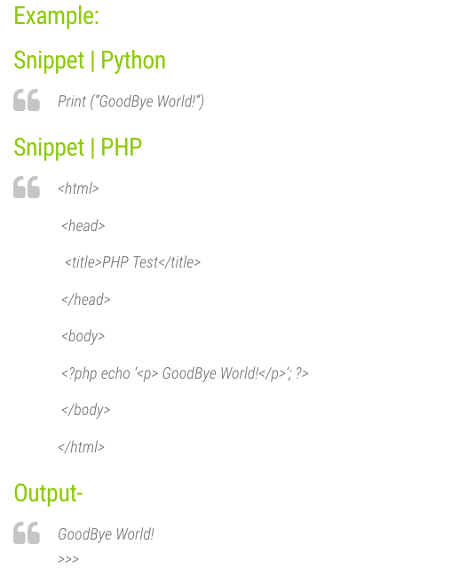
Comparison with other languages
Python vs PHP -Python is much more maintainable than PHP. -Python is much more stable and upward compatible than PHP. -Python snippet executes much faster than PHP. (95% faster)

Slide 14
Syntax
Interactive Mode Programming Invoking the interpreter without passing a script file as a parameter.

Slide 15
Syntax
Script Mode Programming Invoking the interpreter with a script parameter begins execution of the script and continues until the script is finished. When the script is finished, the interpreter is no longer active.

Slide 16
Syntax
Python Identifiers A Python identifier is a name used to identify a variable, function, class, module or other object. An identifier starts with a letter A to Z or a to z or an underscore (_) followed by zero or more letters, underscores and digits (0 to 9). Python does not allow punctuation characters such as @, $, and % within identifiers. Python is a case sensitive programming language. Thus, Manpower and manpower are two different identifiers in Python.

Slide 17
Syntax
Python Identifiers Here are naming conventions for Python identifiers: -Class names start with an uppercase letter. All other identifiers start with a lowercase letter. -Starting an identifier with a single leading underscore indicates that the identifier is private. -Starting an identifier with two leading underscores indicates a strongly private identifier. -If the identifier also ends with two trailing underscores, the identifier is a language-defined special name.

Slide 18
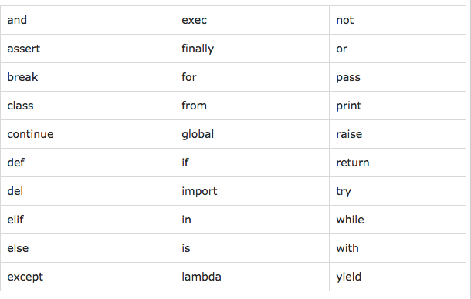
Syntax
Reserved Words

Slide 19
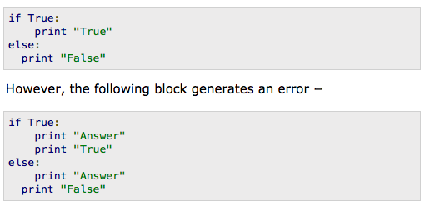
Syntax
Lines and Indentation
Python provides no braces to indicate blocks of code for class and function definitions or flow control. Blocks of code are denoted by line indentation, which is rigidly enforced. The number of spaces in the indentation is variable, but all statements within the block must be indented the same amount.

Slide 20
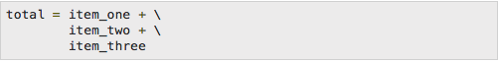

Syntax
Multi-Line Statements
Statements in Python typically end with a new line. Python does, however, allow the use of the line continuation character (\) to denote that the line should continue. Statements contained within the [], {}, or () brackets do not need to use the line continuation character.

Slide 21
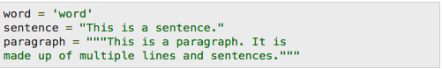
Syntax
Quotation in Python
Python accepts single ('), double (") and triple (''' or """) quotes to denote string literals, as long as the same type of quote starts and ends the string. The triple quotes are used to span the string across multiple lines.

Slide 22
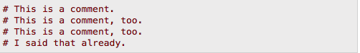
Syntax
Comments in Python
A hash sign (#) that is not inside a string literal begins a comment. All characters after the # and up to the end of the physical line are part of the comment and the Python interpreter ignores them.

Slide 23
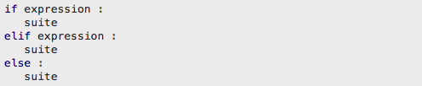
Syntax
Multiple Statement Groups as Suites
A group of individual statements, which make a single code block are called suites in Python. Compound or complex statements, such as if, while, def, and class require a header line and a suite. Header lines begin the statement (with the keyword) and terminate with a colon ( : ) and are followed by one or more lines which make up the suite.

Slide 24
Some Python Libraries
1. wxPython A gui toolkit for python. You will really love it. 2. Pillow Python Imaging Library is a must have for anyone who works with images. 3. NumPy It provides some advanced math functionalities to python. 4. SciPy When we talk about NumPy then we have to talk about scipy. It is a library of algorithms and mathematical tools for python and has caused many scientists to switch from ruby to python. 5. matplotlib A numerical plotting library. It is very useful for any data scientist or any data analyzer.

Slide 25
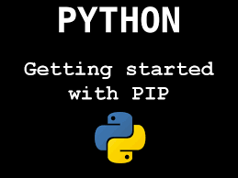
Pip
pip is a package management system used to install and manage software packages written in Python. Python 2.7.9 and later, and Python 3.4 and later include pip by default. pip is a recursive acronym that can stand for either "Pip Installs Packages" or "Pip Installs Python"

Slide 26
Building a library

Slide 27
Code Example and Explanation

Slide 28
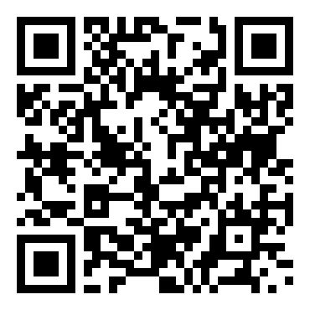
http://bit.ly/2fhvVfT
hayde@reverscore.com

